Slide 1

ENPM 662 - PROJECT 1
Technical Report of Predictive Active Steering Control for Autonomous Vehicle Systems
Charith Reddy Gannapureddy
Raghu Dharahas Reddy Kotla

Slide 2
Table of contents :
Introduction
Scope of study
Dynamics and kinematic equations
Simulation Diagram of NL MPC Controller
Discussion of results of NL MPC Controller
Simulation Diagram of LTV MPC Controller
LTV-MPC Controller Observations

Slide 3
Introduction :
Overview of Industry Trends
Increased integration of electronics, computers, and controls in the automotive sector.
Emphasis on improved functionality and overall system robustness.
Passive vs. Active Safety
Passive safety focuses on structural integrity, while active safety aims at preventing accidents and enhancing controllability.
Particular interest in active safety's role in emergency situations, such as on slippery roads.

Slide 4
Evolution of Active Safety Systems
Historical Perspective
Early active safety systems in the 1980s targeting longitudinal dynamics, ABS, and traction control.
Introduction of various vehicle stability control systems.
Role of Active Front Steering (AFS) Systems
AFS and four-wheel steer (4WS) systems improve lateral vehicle stability.
Application of AFS in autonomous vehicles, including magnetic sensors and lane detection.
Future Prospects
Anticipation of future systems with increased effectiveness.
Introduction of additional actuators (4WS, active steering) and sensors (GPS) for advanced safety.

Slide 5
Focus of the Paper and Model Predictive Control (MPC)
Paper Focus
Specific focus on controlling yaw and lateral vehicle dynamics via AFS.
Assumption of a trajectory planning system in a double lane change scenario on a slippery road.
MPC Overview
Brief introduction to Model Predictive Control (MPC) for vehicle control.
Reference to ongoing research efforts since the early 2000s.
AFS MPC Formulations and Simulation Validation
Introduction of two AFS MPC formulations in the paper.
Challenges in computational burden and solutions, including simulations validation on snow-covered and icy roads.

Slide 6
Scope of study:
Objective:
To develop an MPC-based approach that determines the optimal front steering angle at each time step.
The primary goal is to enable the autonomous vehicle to effectively follow a known trajectory on slippery roads in double lane changing scenario, maximizing entry speed.
Assumptions:
Assuming the availability of a known trajectory over a finite horizon at each time step
Forward velocity is always constant.
Goal:
follow the desired trajectory or target as close as possible.
Fulfilling various constraints reflecting vehicle physical limits.

Slide 7
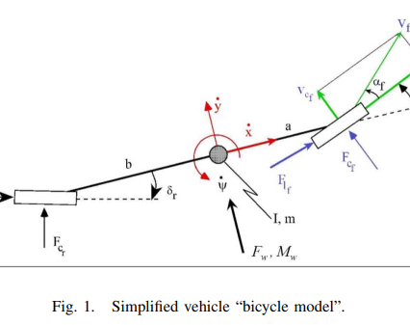
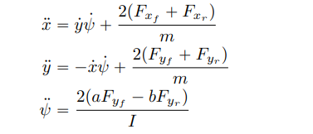


Dynamics and kinematic equations
Dynamic Equations :
Kinematic Equations:
Tire Forces : Longitudinal and lateral tire forces-

Slide 8
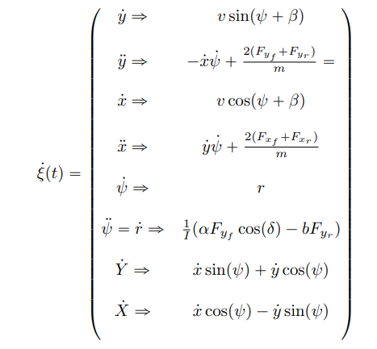
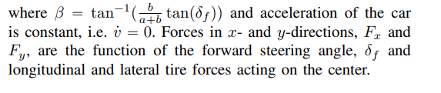
Non-Linear State Space Equation :

Slide 9
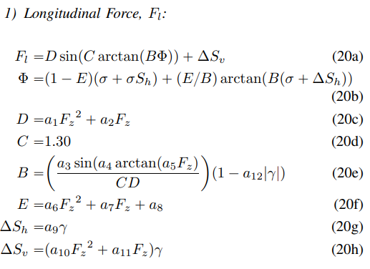
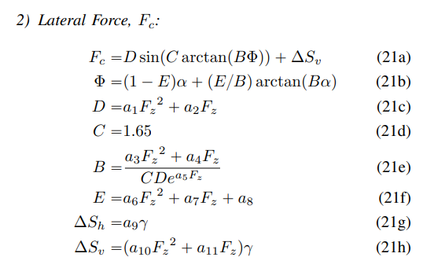
Tire Model:
Final Longitudinal and lateral equations of tire model:
The paper employs the Pacejka Tire Model to calculate tire longitudinal and cornering forces.
The Pacejka model is described as a complex, semi-empirical nonlinear formula that accounts for the interaction between longitudinal and cornering forces during combined steering and braking.
The forces are assumed to depend on slip angle, normal force, slip ratio, and fixed values of friction coefficients.

Slide 10
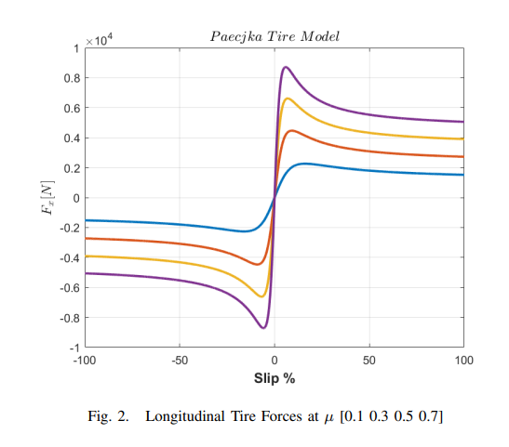
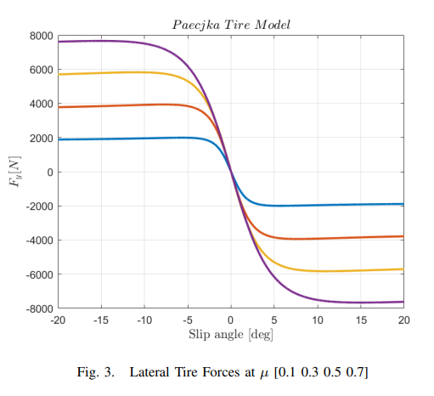
Tire model continues….
Fig. 2 & Fig.3 represents the longitudinal and lateral forces versus longitudinal slip and slip angle, for fixed values of the friction coefficients.

Slide 11
Types of controllers:
NL MPC:
Discretization and optimization for real-time control.
Trade-off management between target tracking and steering effort.
Solve the optimization problem at each time step to find the optimal control inputs, forming the state feedback control law
LTV MPC:
LTV MPC addresses systems that change over time by predicting future behavior and optimizing control inputs accordingly.
Linearize the nonlinear dynamical system around a trajectory to create a linear time-varying model.

Slide 12
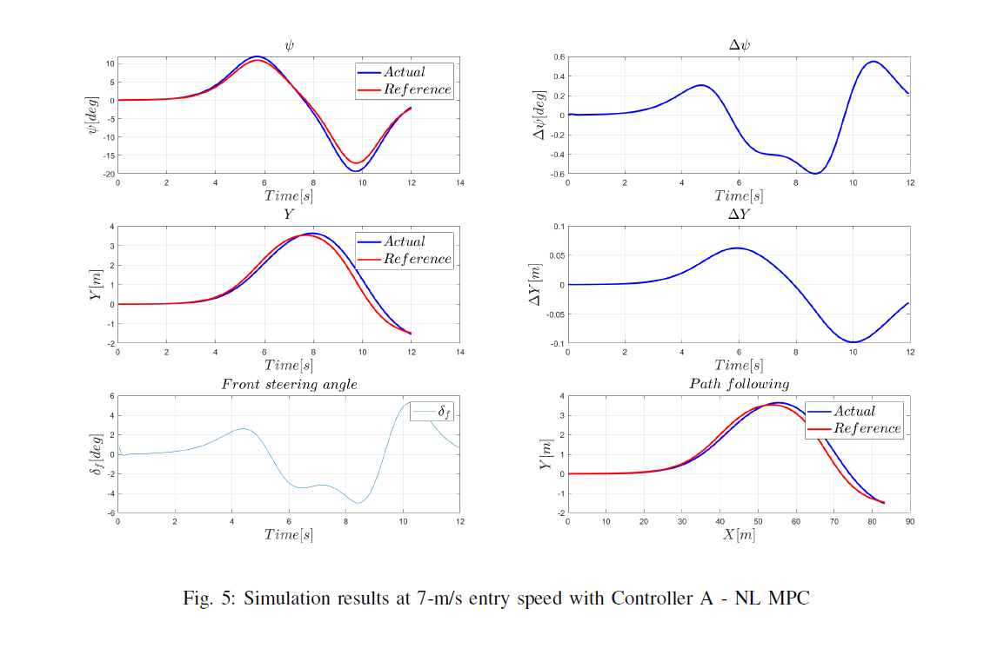
Simulation Diagram of NL MPC Controller at 7-m/s:
Figure-4 Simulation results at 7-m/s entry speed with Controller A - NL MPC

Slide 13
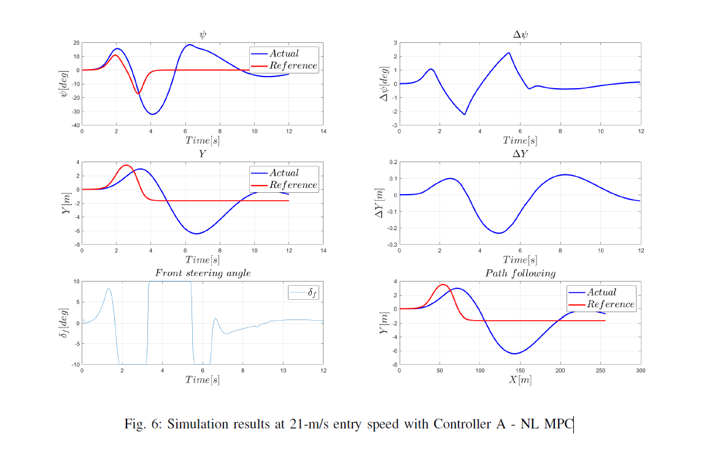
Simulation Diagram of NL MPC Controller at 21-m/s:
Figure-4 Simulation results at 7-m/s entry speed with Controller A - NL MPC

Slide 14
Discussion of results of NL MPC Controller(Fig-5 & Fig-6) :
Optimization Strategy:
FMINCON solver in MATLAB used for non-linear optimization.
Computational constraints addressed by assuming slow entry speeds.
Challenges in path prediction at higher speeds due to increased computational demands.
Simulation Results - Tracking Errors:
Comparison with Original Paper at 7 m/s entry speed and μ = 0.3.
Small tracking errors observed (Yrms = 0.0481, ψrms = 0.055) at slow entry speeds.
Impact of Entry Speed: Highlighted computational challenges and path prediction difficulties at higher speeds.
Controller Behavior at Different Speeds:
Showcased behavior at 7 m/s and 21 m/s entry speeds.
Performance Differences: Effective tracking at 7 m/s vs. challenges at 21 m/s.
Observations: Larger overshoot, longer settling time, and increased computation at higher speeds.

Slide 15
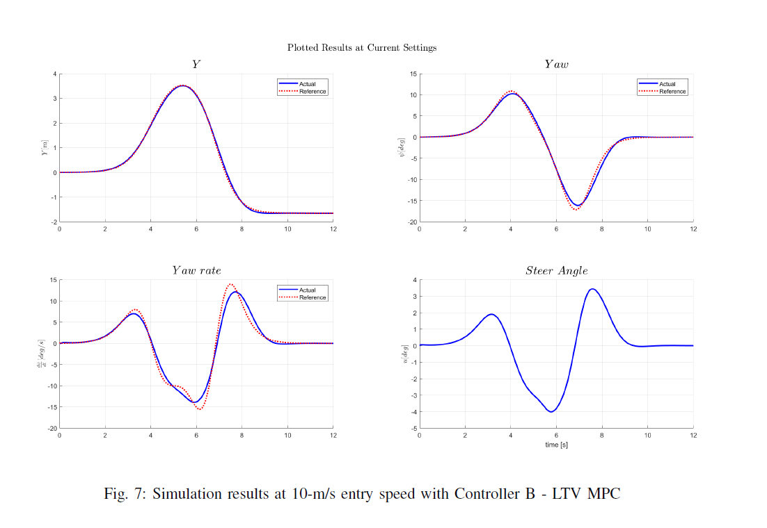
Simulation Diagram of LTV MPC Controller at 10-m/s:
Figure-4
Figure- 5:

Slide 16
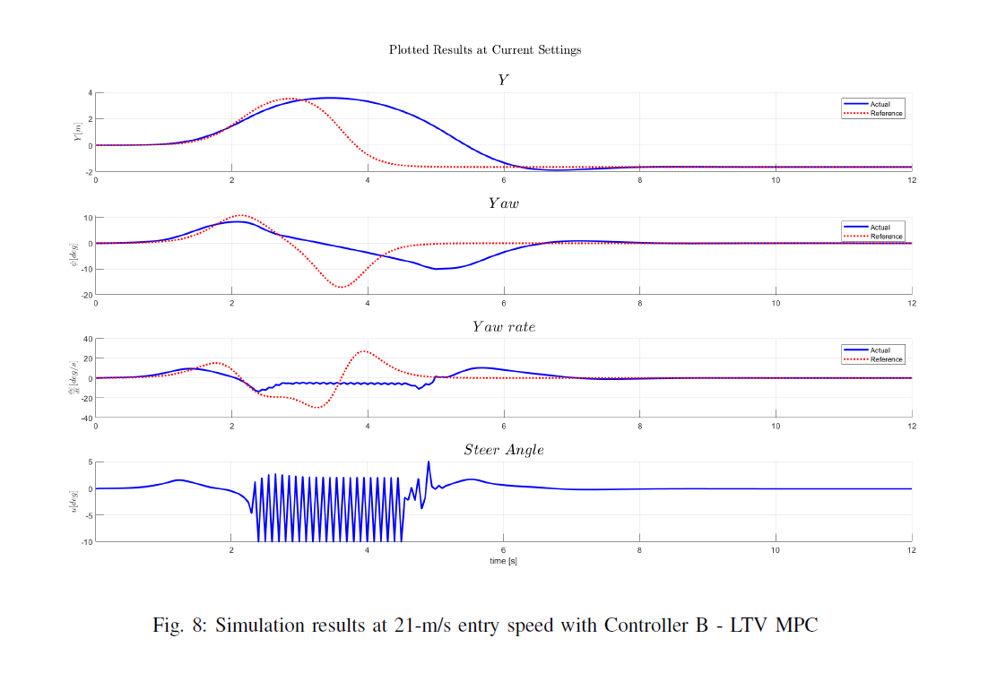
Simulation Diagram of LTV MPC Controller at 21-m/s:
Figure-4
Figure- 5:

Slide 17
LTV-MPC Controller Observations:(Fig-7 & Fig-8)
Implementation:
Linearized nonlinear vehicle dynamics for LTV-MPC.
Analytic differentiation and numeric tire model linearization.
Simulation Results:
Entry Speed Comparison: 10 m/s vs. 21 m/s.
Yaw Rate Tracking: Better accuracy, less overshoot, and quicker settling at 10 m/s.
Front Slip Angle Control: Well-maintained within desired bounds at 10 m/s.
Challenges at 21 m/s: Front slip angle briefly reaches upper bound.
Computational Aspects:
Computation Time: Shorter at 10 m/s due to optimization over a longer horizon at 21 m/s.
Handling Challenges: LTV-MPC copes well with increased momentum and lateral force requirements at 21 m/s.
Conclusion:
10 m/s Performance: Superior control.
21 m/s Performance: Adequate, promising for high speeds.

Slide 18
SIMULATION VIDEO LINKS:
Video link of NL MPC Controller simulation : https://drive.google.com/file/d/11nOxm2GOFtYwKQHlHRiN3n10MFEnv1_U/view?usp=sharing
Video link of LTV MPC Controller simulation :
https://drive.google.com/file/d/1T1qZ8rQjO_ZUgpXDP9Mpn4OXdjktpUof/view?usp=sharing
The above links contains the video of MATLAB simulation to obtain the plots shown in the slides before.

Slide 19

Thank you

